Slide 1





Water Security
Raimund Mair
World Bank Water Global Practice
Europe and Central Asia
Danube Water Conference 2019
20-21 May 2019 | Vienna

Slide 2



Water is essential for the Planet, Life and the Economy
Water sustains the planet
Water is a vital factor of production
Water is the essence of life
2

Slide 3
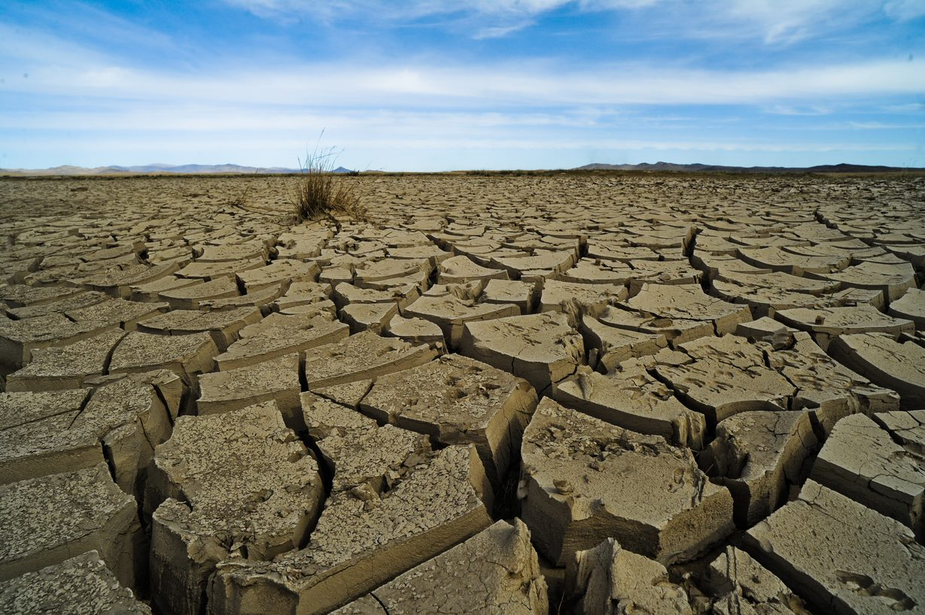
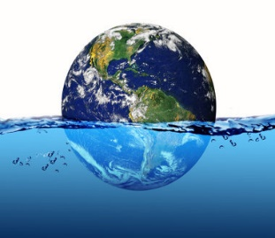
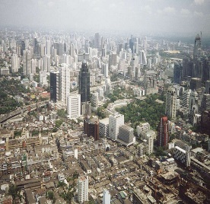
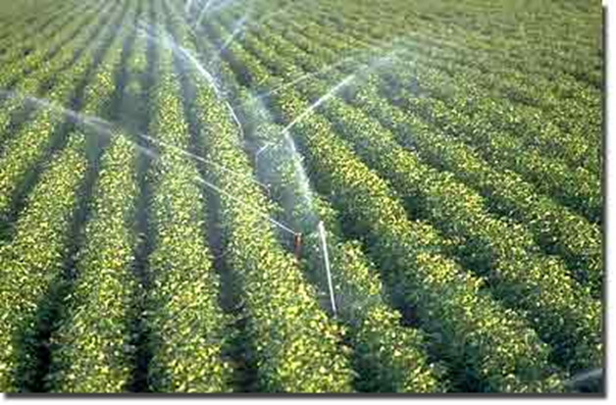
… but the pressure and extremes are increasing
Climate
change
Population growth and urbanization
Consumption patterns and pollution
By 2030, demand for water is expected to exceed supply by 40%
The 2030 Water Resources Group Report
3

Slide 4
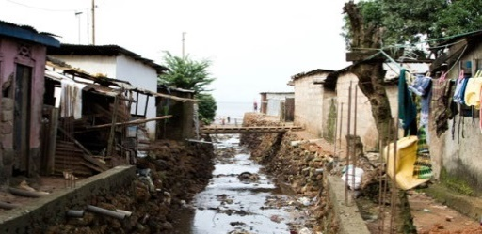
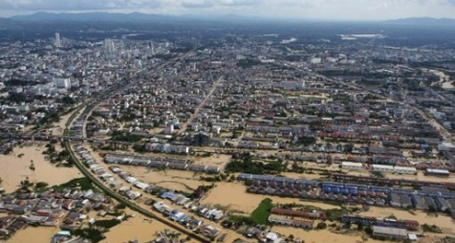
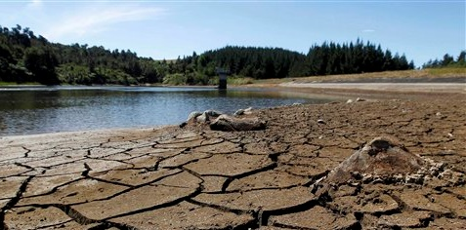
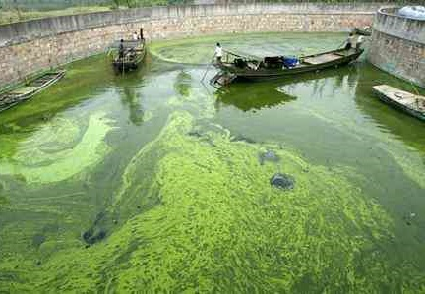
Costs of “water-insecurity”
Inadequate Water Supply & Sanitation: Public health impacts, econ & env losses
Floods: Loss of lives, damage to property and infrastructure, economic loss
Droughts & Water Scarcity: Economic loss, e.g. to food producers & consumers
Ecosystem degradation & pollution: Widespread impacts, not always monetized
4
Notes:
This slide shows some of the economic costs of water insecurity globally. Some of these costs are easier to quantify than others. For instance there is still no global assessment of the costs of freshwater ecosystem degradation and pollution.

Slide 5
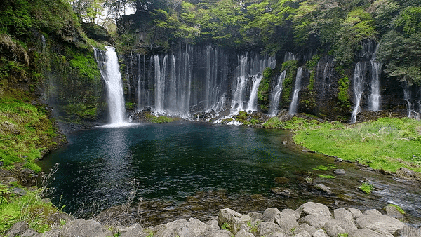



A Water Secure World for All
Sustain Water Resources
Deliver Services
Build Resilience
Notes:
After 4 years of coming together as a Global Practice, we have now taken stock, analyzed our comparative advantages and lessons from implementation, to launch today, on behalf of all staff of the GP, our updated Strategic Action Plan for Water.
Our vision remains a Water Secure World for All, as an implementation arm of all water related SDGs and the global climate commitments.
We will deliver this vision through three inter-related pillars:
Sustain Water Resources
Deliver Services
Build Resilience

Slide 6
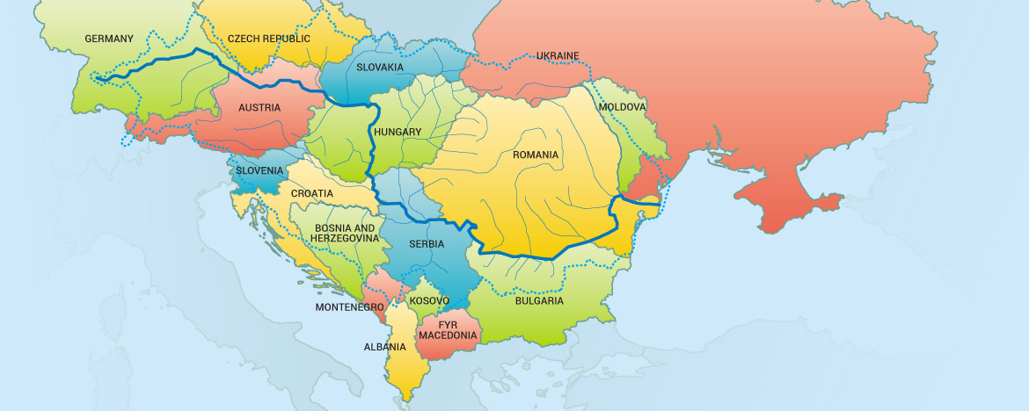
Danube Water Program
Danube Water Program 3rd Phase 2019-2021
“Building a Danube Water Security Platform”
Continuation and consolidation of successful activities of previous phases on water services (WSS)
Extending scope towards “Water Security”

Slide 7

Water security
Conceptual framework
Sustain
water resources
Institutions
Information
Climate change
Demographic changes
By managing
Mitigate
water risk
Infrastructure
Deliver
water services
Economic development
Technologies and practices
… to optimize outcomes for people, economy and environment

Slide 8
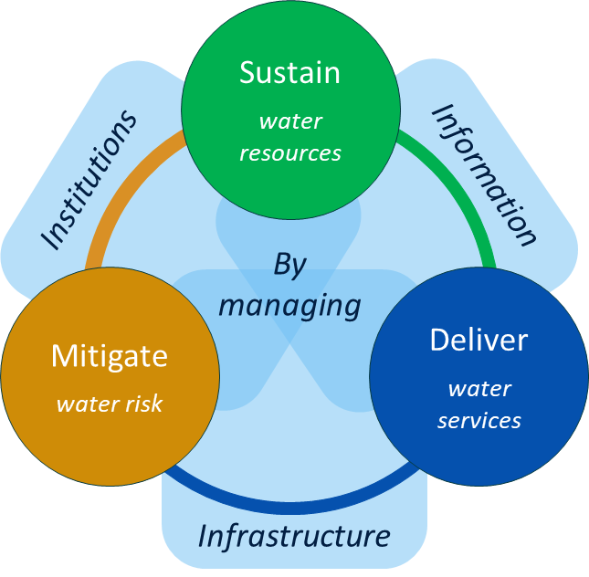
Managing water security
INFORMATION – You can’t manage what you don’t measure
Data → Knowledge → Insight → Decision → Outcome
Data requirements
  Hydro-meteorological and environmental data
  Data on water use
  Data on infrastructure
  Land use practices
  etc.
Data on future developments
  Climate variability
  Demographic changes
  Data on economic and sectorial development plans
  etc.
Data accessibility?

Slide 9
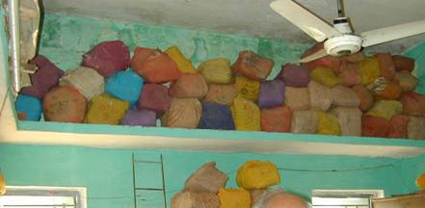
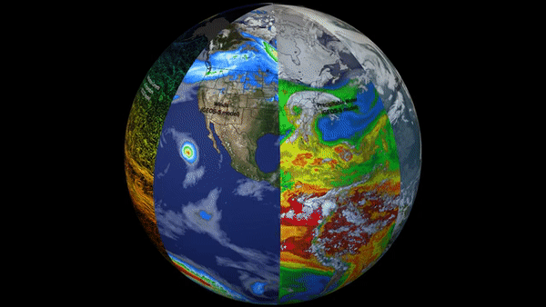
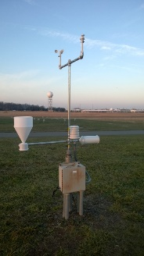
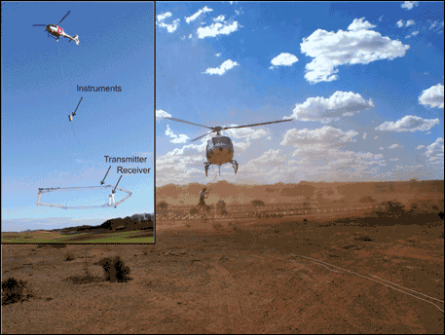
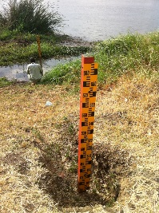
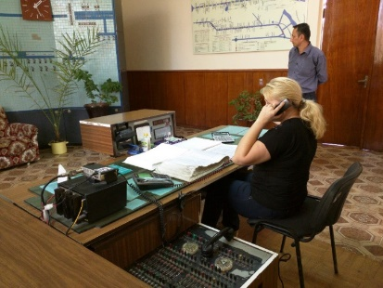
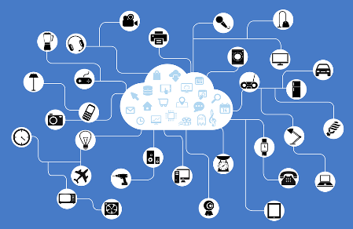
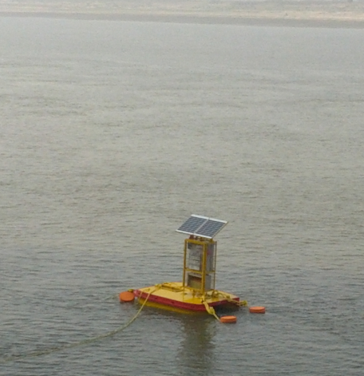

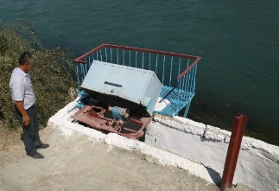


Data – before and after
Before…
After…

Slide 10
Managing water security
INFRASTRUCTURE
… to sustain water resources, deliver services, mitigate risk
  Water supply and sanitation infrastructure
  Flood protection
  Irrigation schemes
  etc.
Grey and green infrastructure
  Socio-economic objectives
  Environmental objectives
Related questions
  Financing of infrastructure?
  Technological development?
  Stranded assets?

Slide 11
Managing water security
INSTITUTIONS
Institutional setup and governance aspects important elements of water security
Legislative framework and policies
Managing inter-sectorial issues
Transboundary management
Aspects of EU approximation

Slide 12
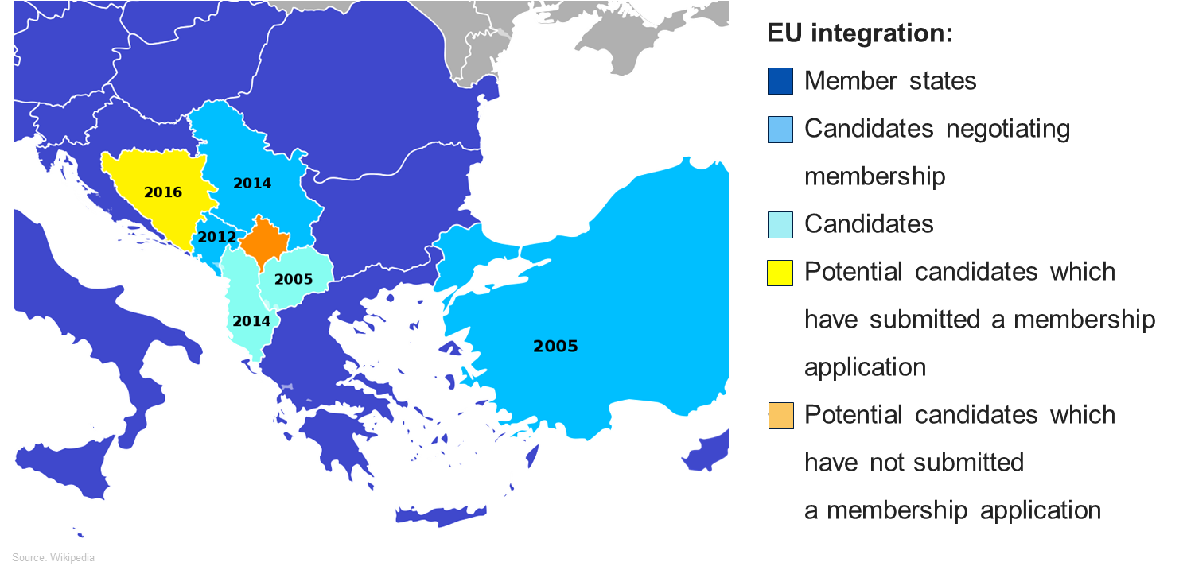
Consideration of EU context, ongoing activities and established water management framework
EU directives (WFD, FD, UWWTD, DWD, etc.)
RBMPs and FRMPs
Existing RBOs (i.e. ICPDR, ISRBC)
Accomplished/ongoing Water Security diagnostics
etc.

Slide 13
Summary and Outlook
Danube Water Program
  Continuation and consolidation of important past and ongoing activities on water services
  3rd Phase 2019-2021: Extending scope towards “Water Security”
Water security diagnostic for the Danube region
More targeted activities on specific subjects
Building on past and ongoing activities
Contributing with new/additional perspective to water management agenda in the region

Slide 14
Thank you!
Raimund Mair
World Bank Water Global Practice
Europe and Central Asia

